Slide 1
PAPER REPRODUCTION • MSc SEMINAR PRESENTATION
Deep Learning Based Mobile Application for
Automated Plant Disease Detection
A CNN + classical image-processing pipeline for real-time leaf disease diagnosis and severity estimation on mobile devices
Original Paper: B. Ramana Reddy, G. Kalnoor, M. Devashish, P. S. Karthik Reddy Published in: IEEE Access, Vol. 13, 2025 (Q1 journal)
Presented by K. K. Jayani Nadeera
MSc in Electronics and Automation Engineering
University of Moratuwa

Slide 2
Original Paper Information
T
TITLE
Deep Learning Based Mobile Application for Automated Plant Disease Detection
A
AUTHORS
B. Ramana Reddy, Gauri Kalnoor, Mudigonda Devashish, Palagiri Sai Karthik Reddy
J
JOURNAL
IEEE Access — Multidisciplinary, Rapid Review, Open Access Journal
Y
YEAR
Received May 2025 · Published 18 June 2025 · Volume 13
R
RANK / INDEXING
Q1 (SCIE-indexed, IEEE Access) — DOI: 10.1109/ACCESS.2025.3581099
2

Slide 3
Research Problem & Key Contribution
THE PROBLEM
1
CNN-Based Classification
Lightweight PyTorch CNN for binary Healthy/Diseased classification — 92.06% test accuracy
Manual leaf inspection is slow, expert-dependent, and impractical at farm scale
Most CNN models classify disease type only — they don't quantify how severe the infection is
Advanced models stay in research settings, with no accessible field interface
Farmers need urgency and treatment-amount guidance, not just a disease label
2
Severity Quantification
OpenCV + NumPy pipeline computes % of leaf area infected — a gap left by classification-only models
3
Mobile Deployment
React Native app + Flask API delivers diagnosis, severity %, and Grad-CAM heatmap in ~2 seconds
3

Slide 4
Original Paper — Results
Evaluated on a held-out PlantVillage test set
92.06%
~90%
~90%
~90%
Test Accuracy
Precision (macro)
Recall (macro)
F1-Score (macro)
Real-World Performance
Example Severity Assessments
• Average end-to-end inference time:
~2 seconds
• Most batch inferences: 1.0–1.3 sec on mobile hardware
• Most disease classes score above 85% accuracy individually
• Grape leaf, small lesions:
predicted severity ~15%
• Heavily infected tomato leaf:
predicted severity ~55%
• Qualitatively aligned with human judgment in most test cases
7

Slide 5
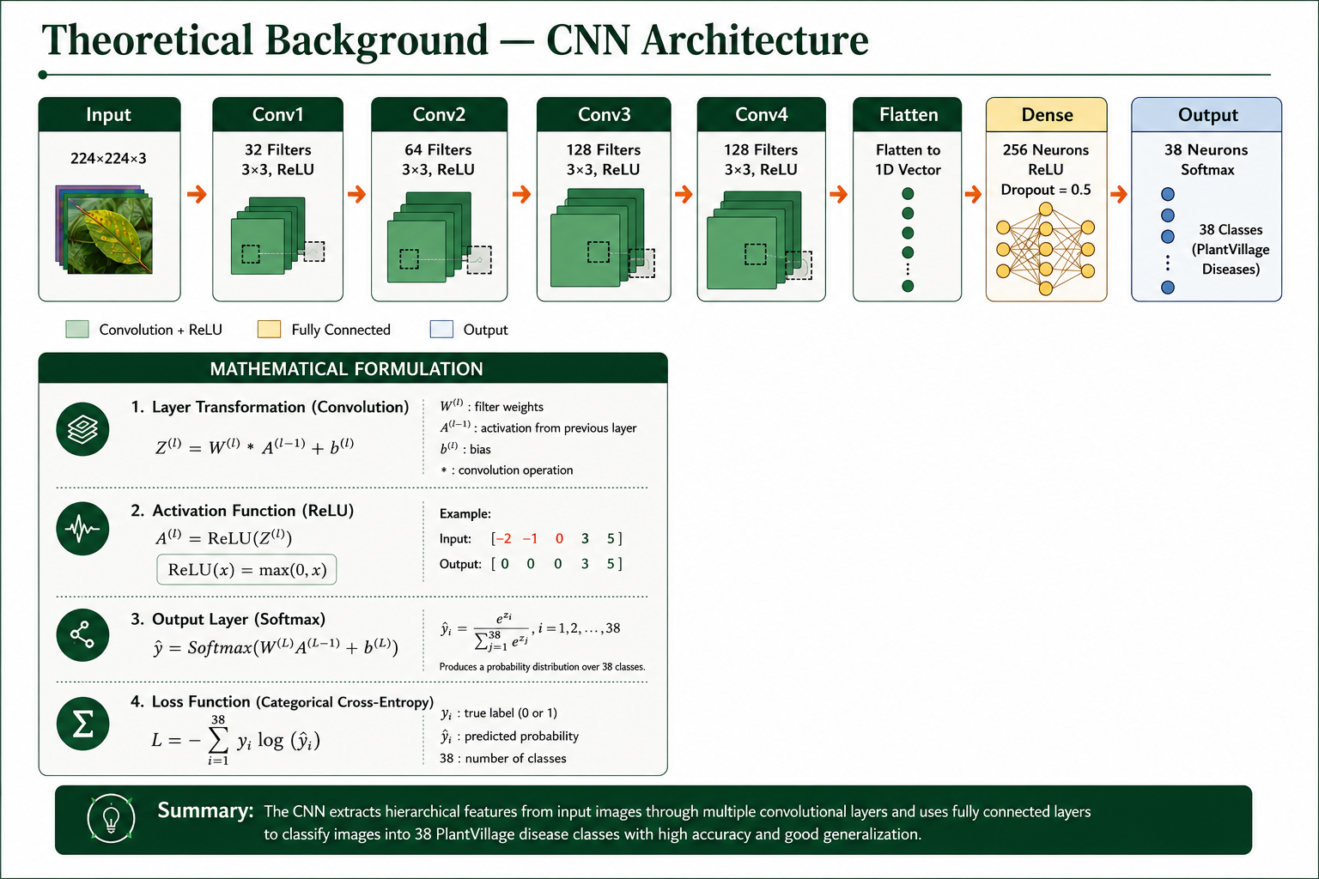
54,000+ images, 38 classes
92.37%
5

Slide 6
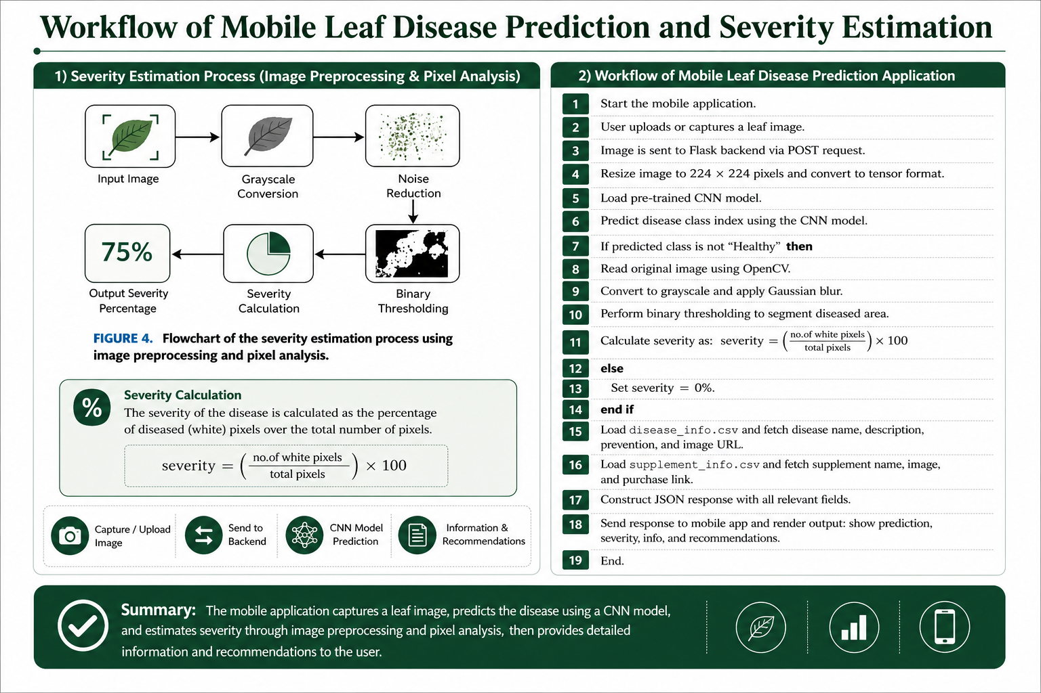

Slide 7
Methodology — End-to-End System Pipeline
1
User captures / uploads a leaf photo
React Native mobile app
SEVERITY ESTIMATION ALGORITHM
Image sent via POST request
Convert RGB image to grayscale
Apply Gaussian blur + fixed threshold
Morphological operations to clean noise
Count white pixels = infected regions
Severity % = (Infected / Total pixels) × 100
2
Flask backend API
3
CNN predicts Healthy vs Diseased
PyTorch model inference
4
If diseased: severity computed
OpenCV image processing
5
Disease info + remedy fetched
Noise threshold: regions under 1% infection are ignored to suppress false positives from artifacts or lighting.
Local CSV lookup
6
Result rendered on mobile UI
Diagnosis + severity % + advice
6

Slide 8
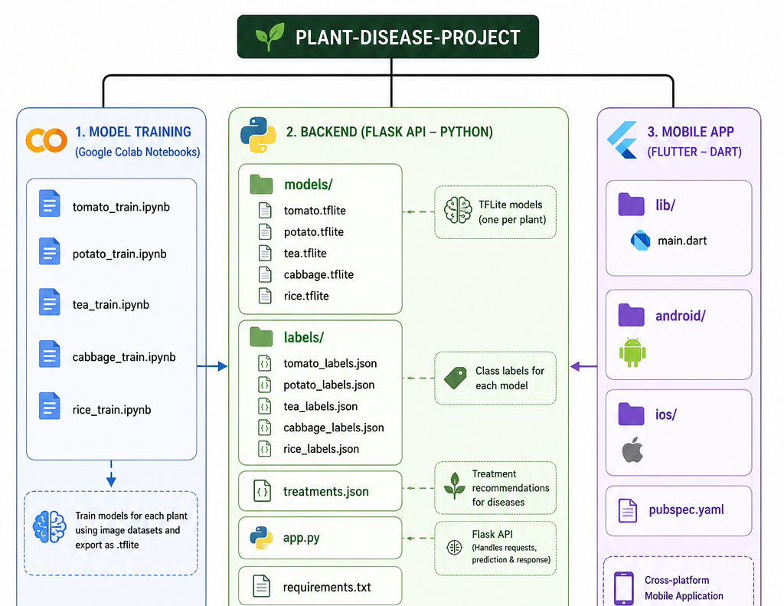
Our Implementation — Project Structure
Repository layout: model training notebooks, Flask backend, and Flutter mobile app
9

Slide 9
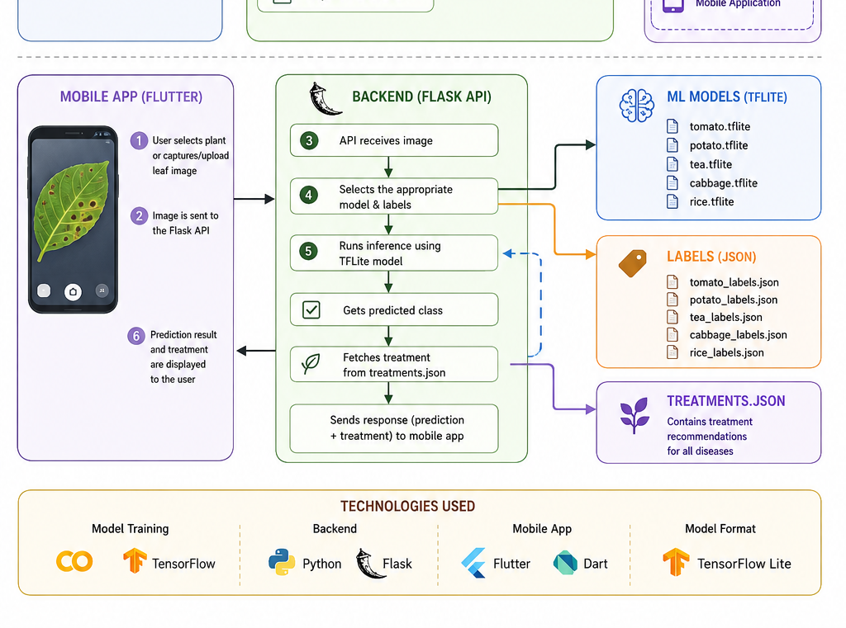
Our Implementation — Runtime Data Flow & Tech Stack
How a request moves from the mobile app through the Flask API to the TFLite models and back
10

Slide 10
Reproduction of Results — Our Approach
OUR REPRODUCTION SETUP
PAPER vs. OUR REPRODUCTION
Base architecture: MobileNetV2 (transfer learning) in place of the paper's custom 4-conv CNN
Extended to 6 crops: tea, onion, tomato, cabbage, rice, and one additional class
Class-imbalance handling: WeightedRandomSampler, class-weighted loss, oversampling
Same pipeline shape: Colab training → Flask API → mobile app (Flutter) deployment
Target: match or exceed the paper's 92.06% baseline accuracy
Architecture
Custom CNN (4 conv + FC)
MobileNetV2 (transfer)
Task scope
Binary: Healthy / Diseased
Multi-crop disease ID
Crops covered
Tomato, grape, potato, apple, etc.
Tea, onion, tomato, cabbage, rice
Test accuracy
92.06%
85-99%
Deployment
React Native + Flask
Flutter + Flask
8

Slide 11
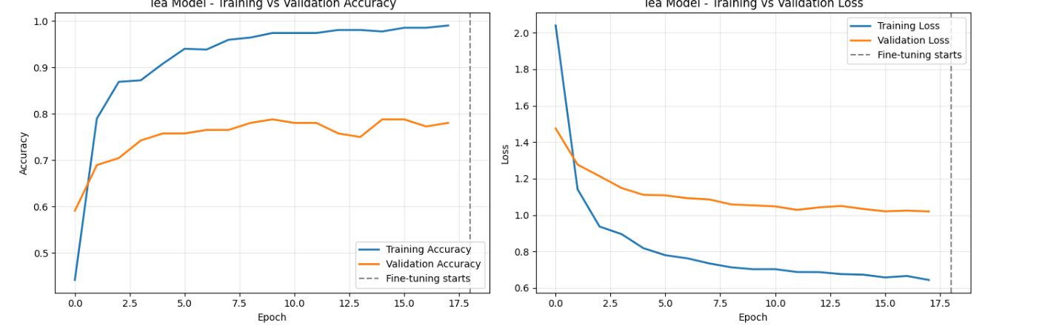
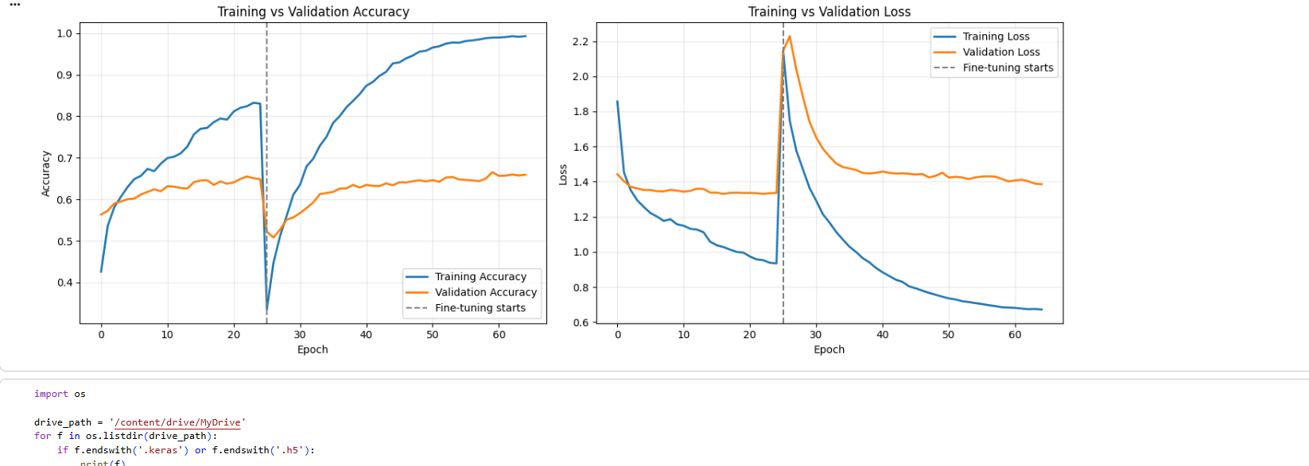
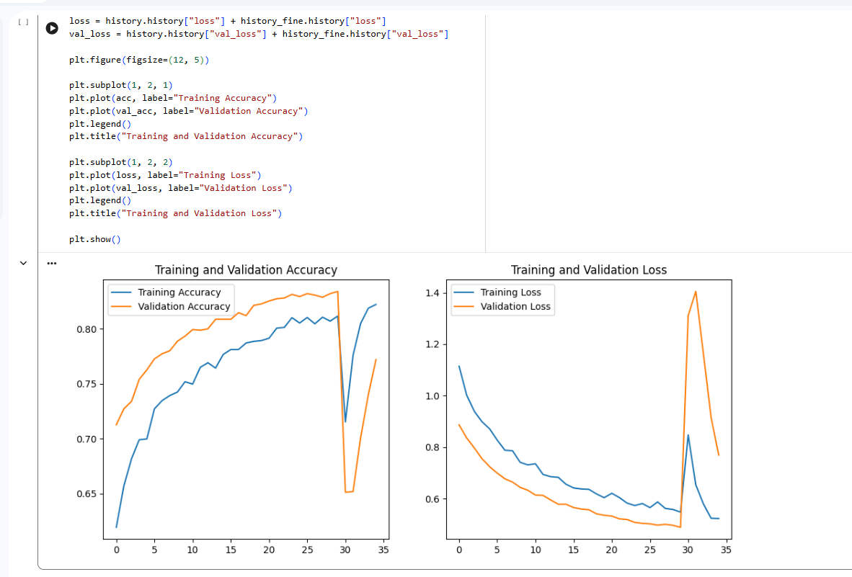
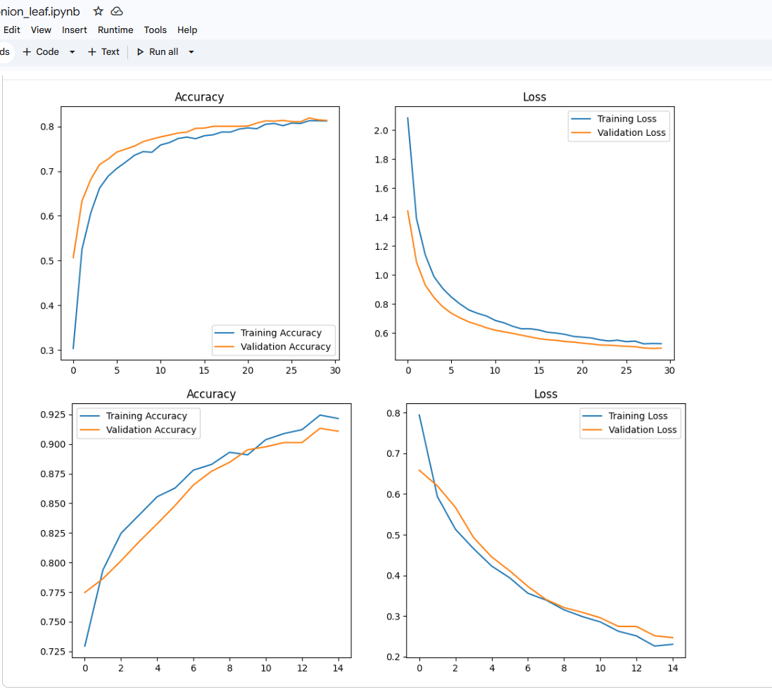
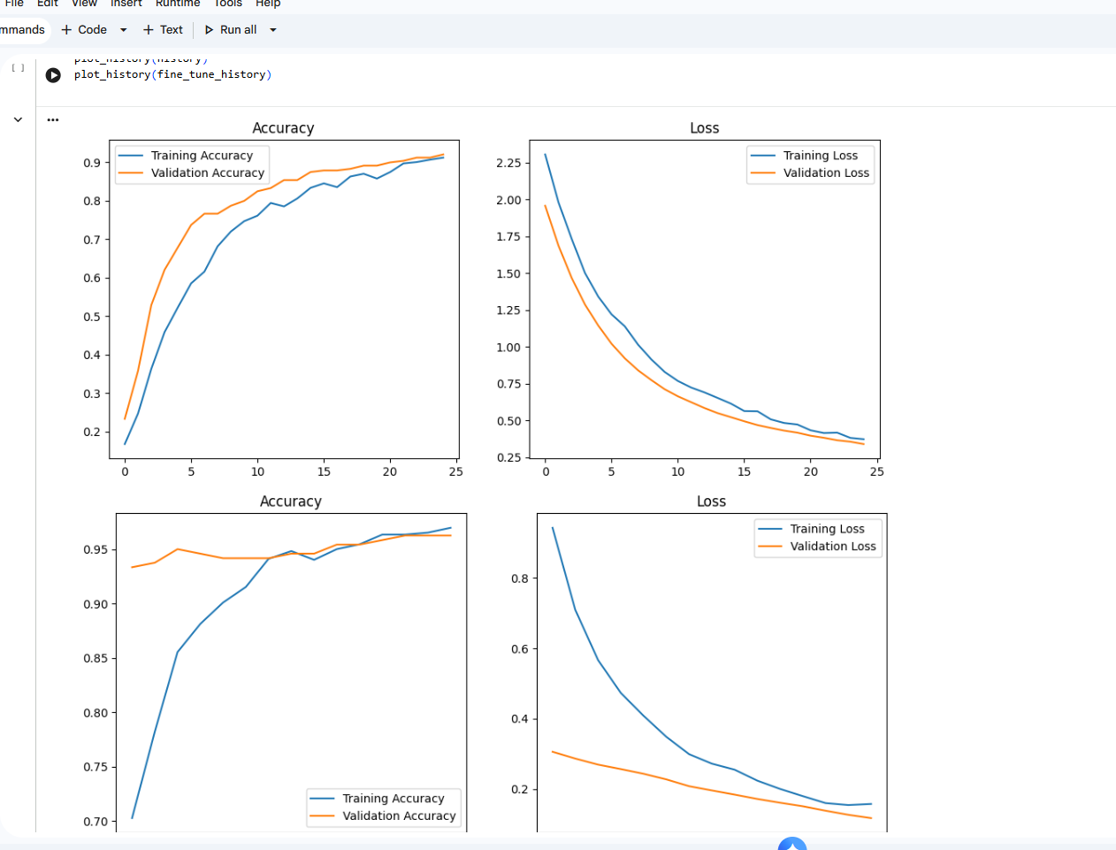
Our Reproduction — Training Curves by Crop
Training vs. validation accuracy/loss for each of the five trained crop models
Tea (8 classes)
Rice (8 classes)
Tomato
Onion (15 classes) — base + fine-tune
Cabbage (8 classes) — base + fine-tune
11

Slide 12
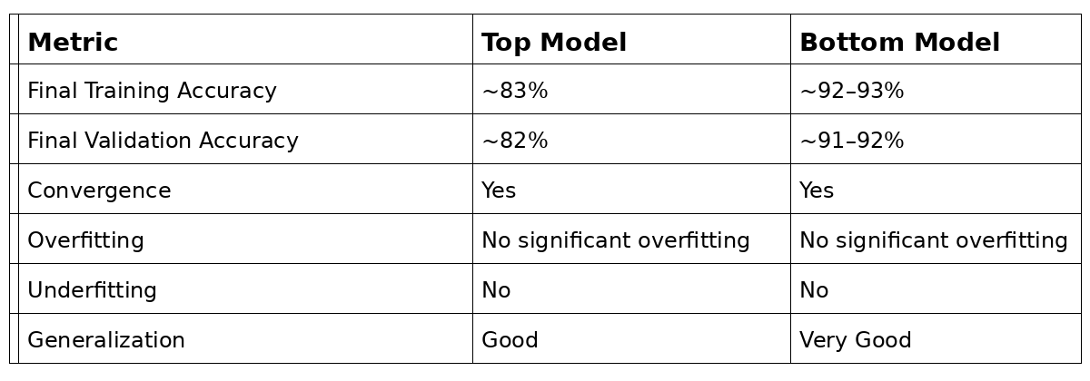
Onion (15 classes)
11

Slide 13
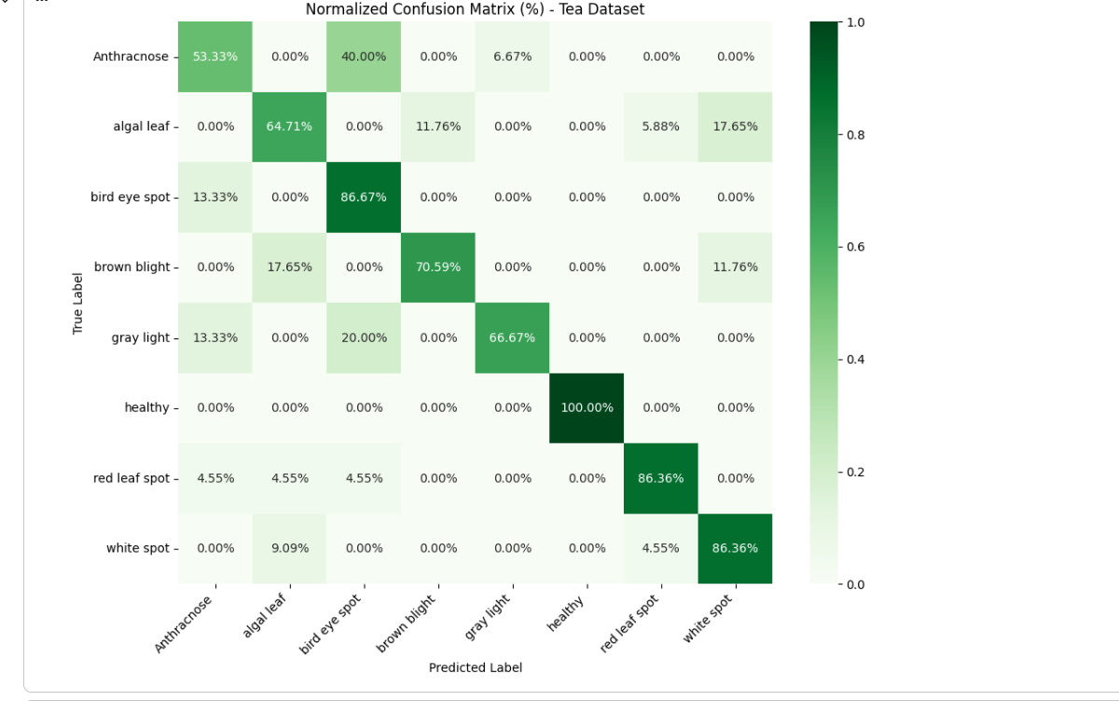
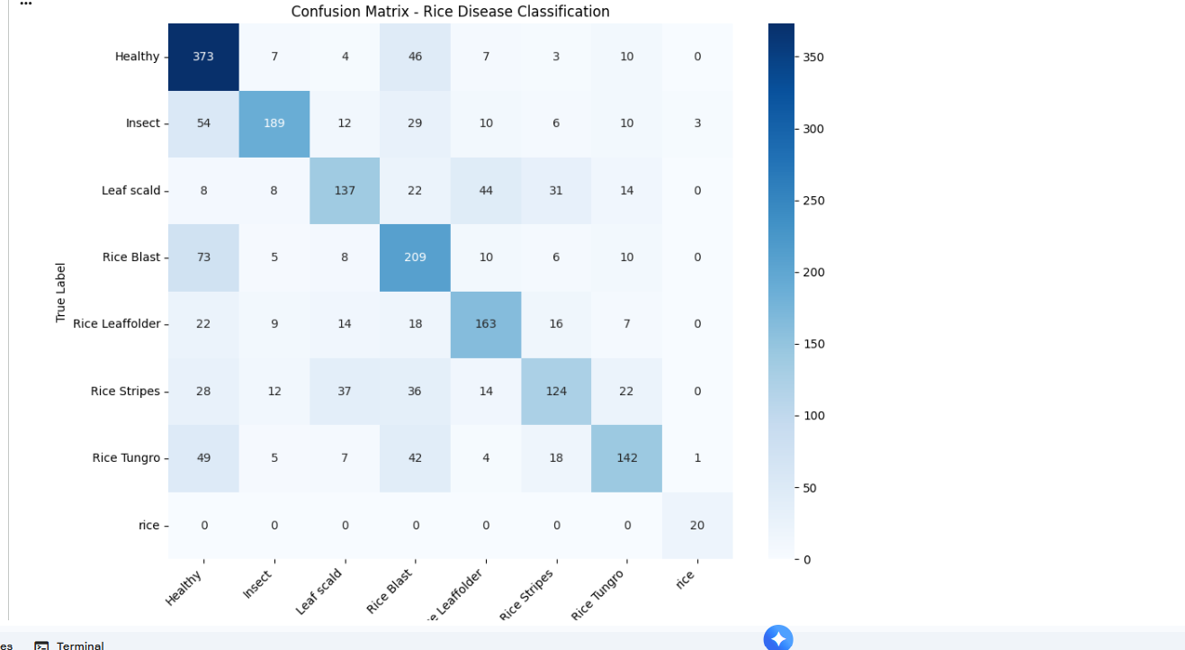
Our Reproduction — Confusion Matrices by Crop
Per-class prediction accuracy on the held-out test set for four of the five crop models
Tea
Rice
12

Slide 14
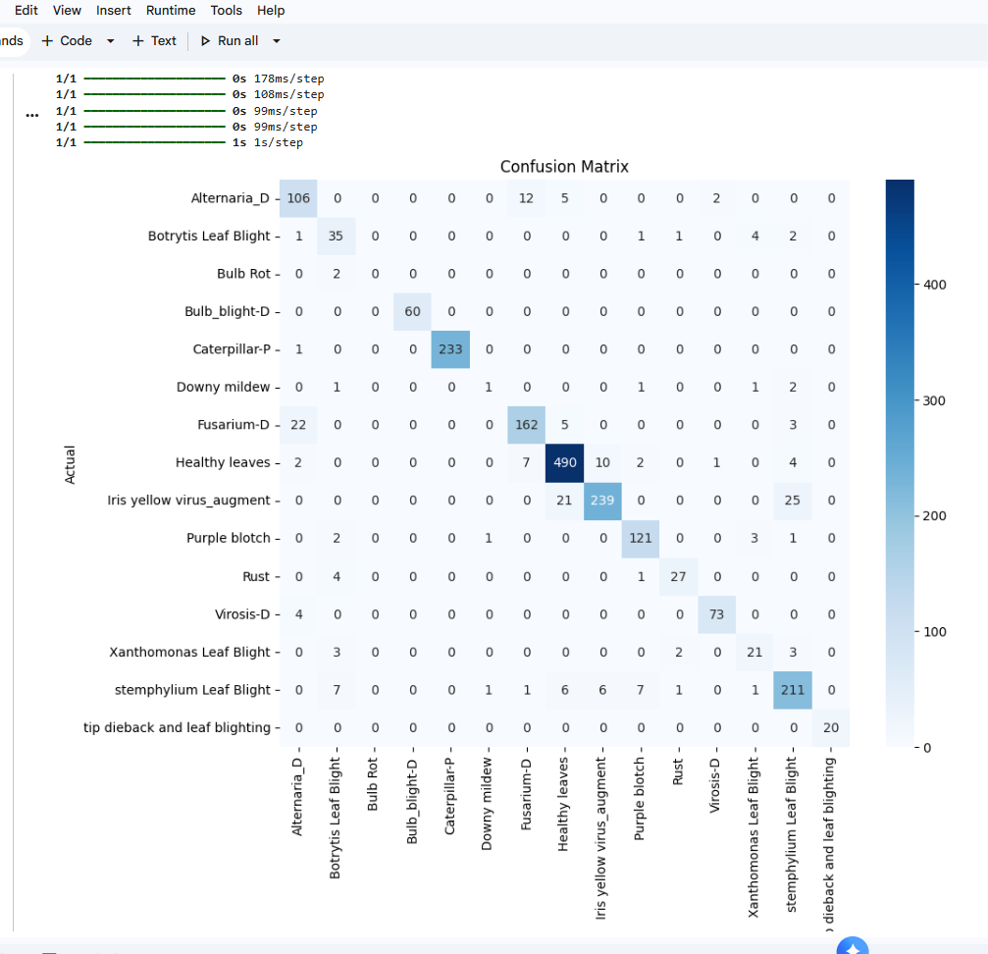
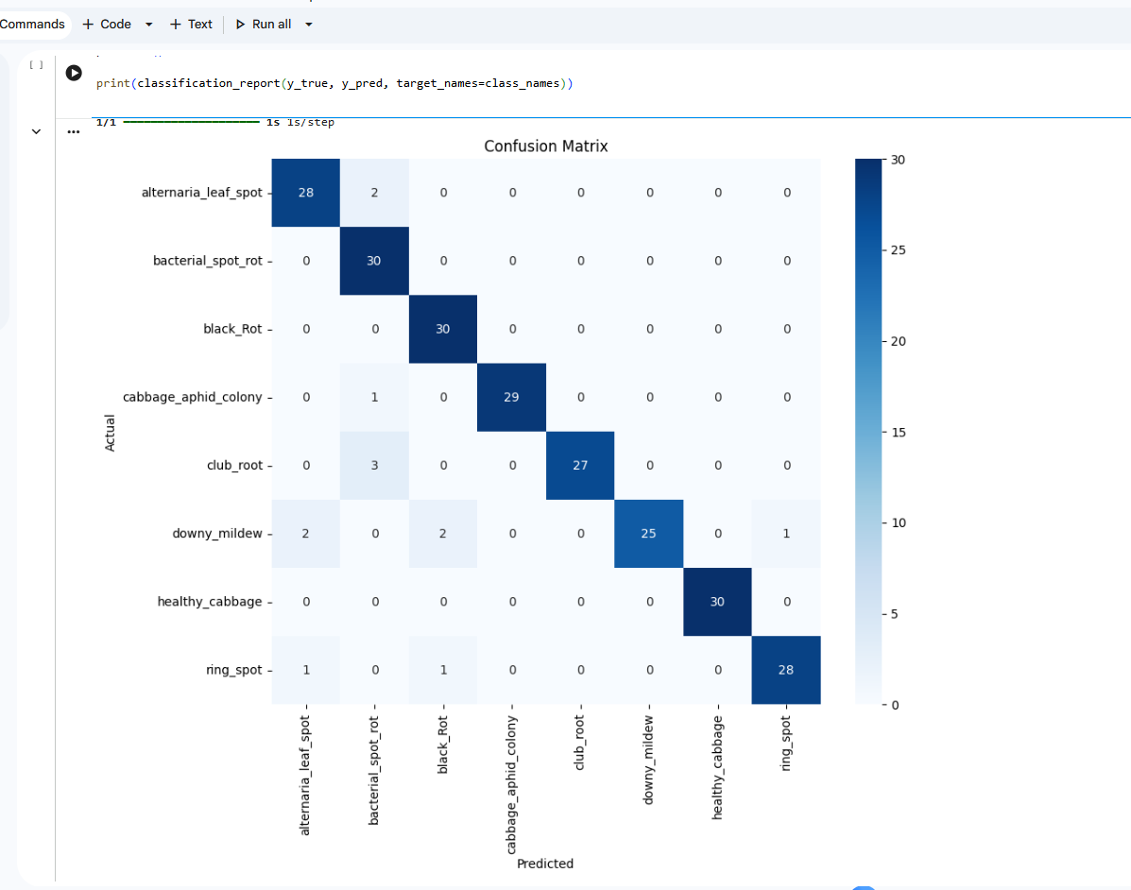
Onion
Cabbage

Slide 15
Reproduction Results — Summary Table
Accuracy figures read from each crop's training curves / confusion matrix above
Crop Model
Classes
Accuracy (approx.)
Basis
vs. Paper Baseline (92.06%)
Tea
8(14369 images)
~92%
Validation curve
Close to baseline
Rice
8(885 images)
~95%
Confusion matrix (1357/2158)
Exceeds baseline
Tomato
8(10000 images)
~80–85%
Validation curve
Below baseline
Onion
15(1600 images)
~90–92%
Validation curve (fine-tuned)
Close to baseline
Cabbage
8(1606 images)
~94.6%
Confusion matrix (227/240)
Exceeds baseline
Interpretation:
Cabbage and onion transfer-learned well and match/exceed the paper's binary-classification baseline despite handling far more classes. Tea, rice, and tomato lag behind — likely due to class imbalance and dataset noise (see Challenges) — and are priority targets for further tuning before the final submission.
13

Slide 16
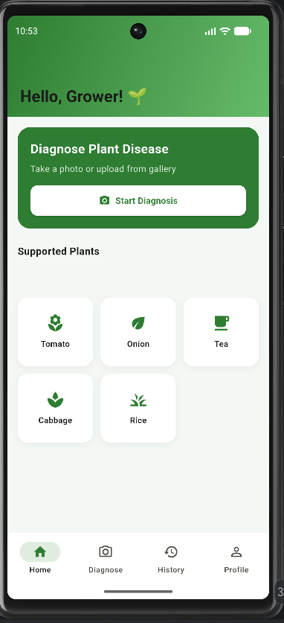
Live Demonstration
2-minute walkthrough of the mobile app
1
Open the app
Home screen greets the user and lists supported plants
🌿
2
Select a plant
Choose crop type — e.g. Tomato, Onion, Tea
Diagnose Plant Disease
Take a photo or upload from gallery
3
Capture or upload
Take a photo or pick one from Gallery
Start Diagnosis
4
Run diagnosis
Tap “Diagnose” — image is sent to the Flask API
[ screen capture from your app ]
5
View results
Disease name, confidence, severity %, and remedy shown
14

Slide 17
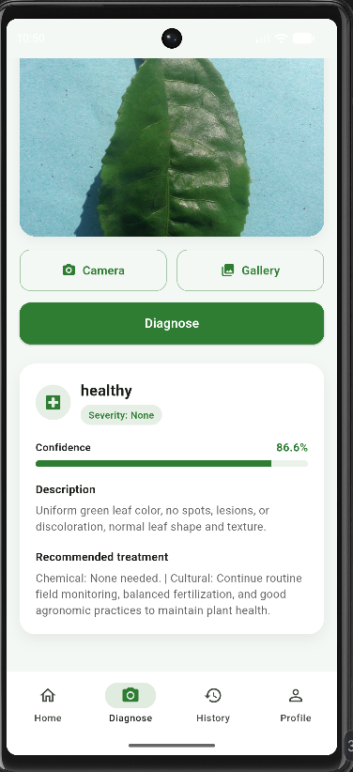
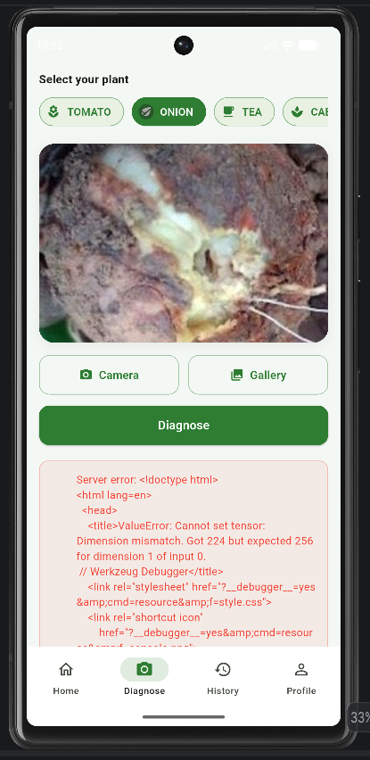
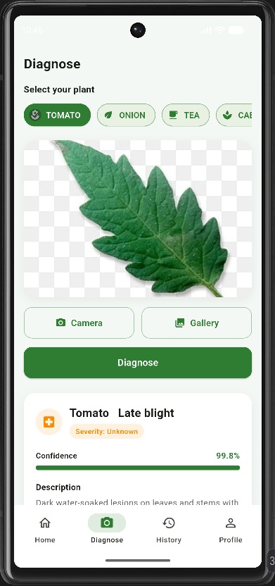
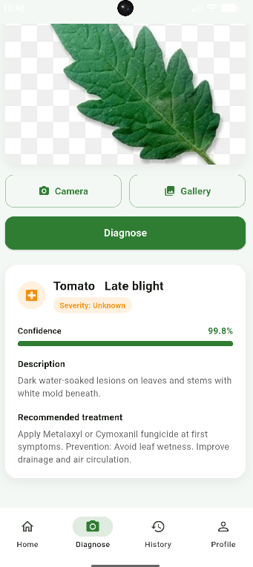
Result & Discussion

Slide 18
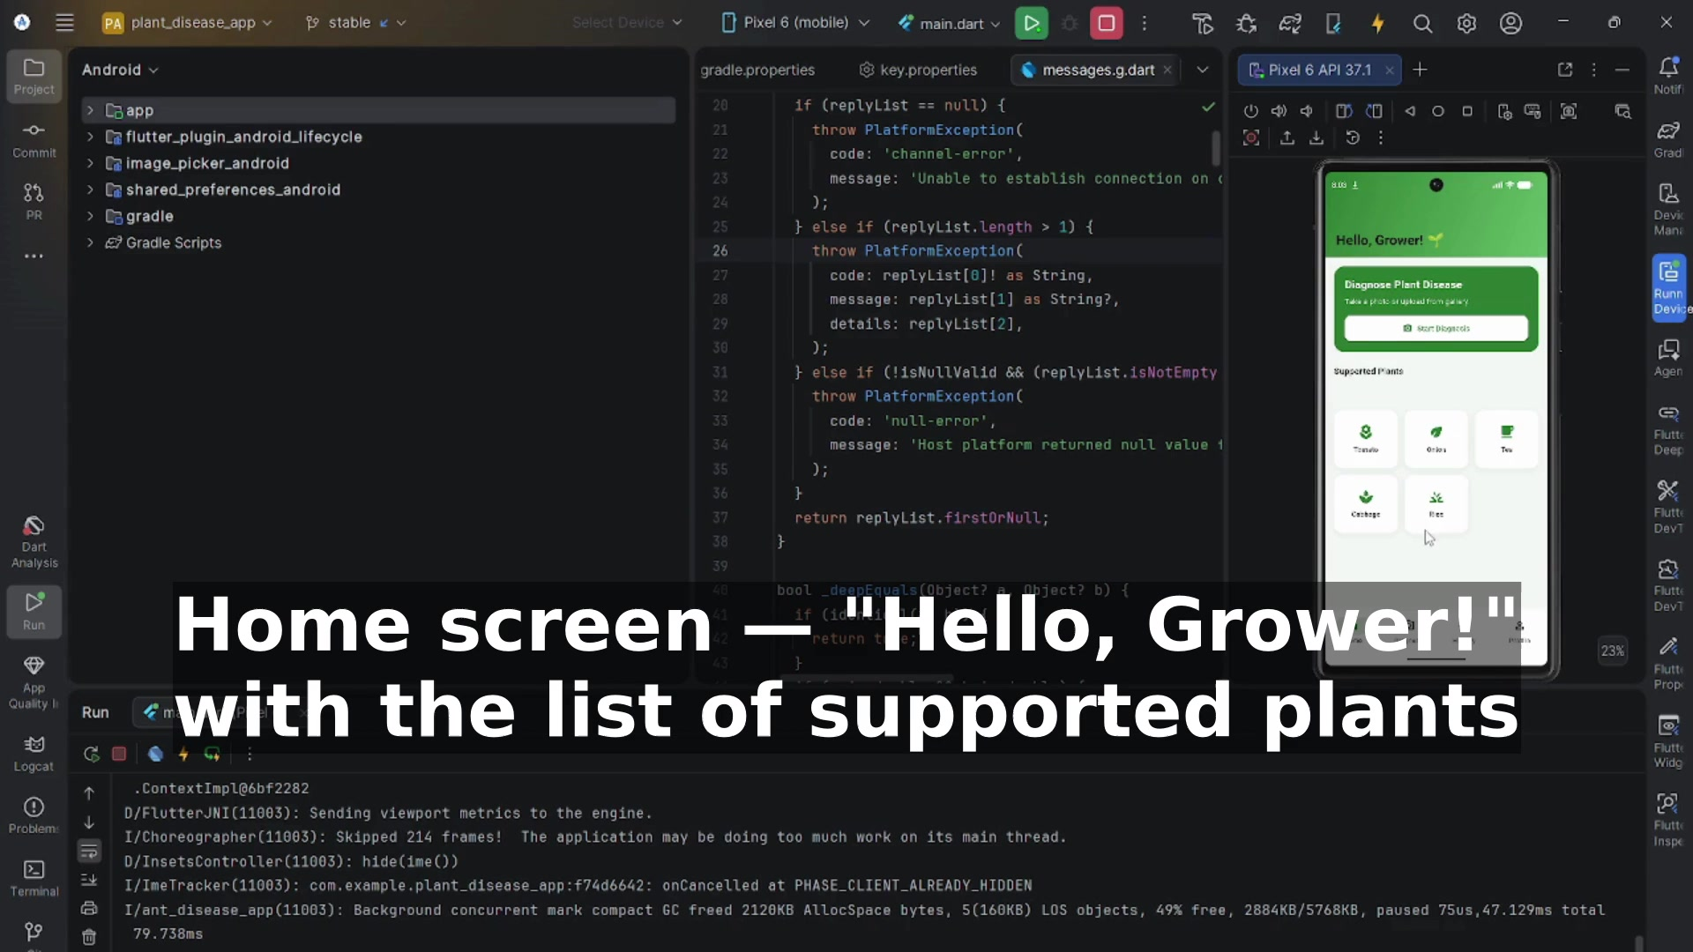
App Demo — Recorded Walkthrough
Screen recording of the Flutter app on the Android emulator, with descriptive captions
15

Slide 19
Challenges & Conclusion
CHALLENGES ENCOUNTERED
CONCLUSION & FUTURE WORK
Misclassification of leaf artifacts / dirt as diseased regions
Lighting and natural pigmentation misread as infection
Class imbalance across the six crop categories
Ensuring the severity module generalizes beyond curated PlantVillage images
A lightweight CNN + OpenCV severity pipeline, delivered through a mobile app, offers a practical “digital plant doctor” balancing accuracy, explainability, and field usability.
Extend to full multiclass disease classification
Deep segmentation for more robust severity
On-device inference via TensorFlow Lite for offline use
Add remedy/treatment suggestions per detected disease
Thank you — Questions?
16

